Slide 1
Toronto Housing Trends
Ryan Chan

Slide 2
Problem
Investigate the cost of condos, detached, and semi detached homes across different district in Toronto
What is the relationship between the cost of homes and venues around the area? Can we find a trend?

Slide 3
Data Acquisition
The price of condos, detached, and semidetached homes is taken from here.
The center of each district is approximated, and using Google Maps, the longitude and latitude of the district is recorded
Using Foursquare API, venues in a 2km radius form the center of each district is retrieved.

Slide 4
Results - Condo
Condos have a more linear relationship between lower and higher cost units.
The increase in price over the last 5 years is around $200,000 to $300,000 across the city.

Slide 5
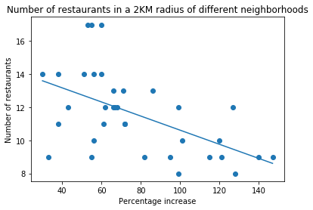
Results – Condo cont
Due to the consistent cost increase across the city, we see a trend of common stores and venues found in certain areas. Districts that contain more expensive apartments and condos are dominated by restaurants.
Areas with lower valued apartments still contain many restaurants in their top twenty most common venues, but contain more stores that suit family needs such as pharmacies or exhibits such as zoos and museums.

Slide 6
Results – Condo cont
Generally, condos in the central district are worth more than those in the east and west district. Considering the location of these districts, these more valuable condos are located in downtown Toronto, more suitable for work environments over families or areas for exhibits like zoos to thrive.

Slide 7
Results - Houses
Unlike condos and apartments, there is more variance between the cost of houses in different areas of Toronto, where the more expensive houses are multiple times more expensive than the least valuable homes.

Slide 8
Results – Houses cont
The increase of price for detached and semidetached houses over the last five years is very different depending on the district the home is located.
Generally, for houses with the higher initial price, the magnitude of the price increase is larger than the increase in price of cheaper houses.
Despite the larger increase in price, the percentage of its price increase is smaller given larger initial cost.

Slide 9
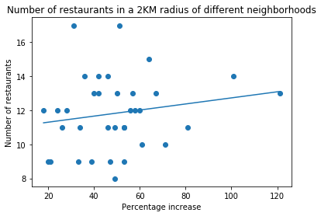
Results – Houses cont
These more expensive houses are mostly located in central district
Thus, with the gap between cheaper and expensive houses growing, we see no evident trend in the number of restaurants to the percentage increase in price as we saw in condos.

Slide 10
Summary
Average cost of condos is small range.
Price increase over last 5 years is approximately equal for all districts. Range between most expensive to cheapest condos same as 2014
Average cost of detached/semi detached homes has large range.
Range further increased as expensive homes increased at a faster rate than cheaper homes
In both scenarios, central districts generally contain the most expensive homes. These expensive homes are surrounded mainly by restaurants, with only a few popular venues not for food, such as banks or pharmacies.
Cheaper homes in the east and west have more variety in popular venues, with less cuisines.

